Slide 1
Intro Questions and Verbal Consent
What does NBA stand for?
What does PPG stand for?
Who is the all time leading Scorer?
What does PER stand for?
Who was the most recent 6th man of the year?

Slide 2
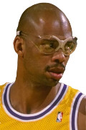
Notes:
Kareem Abdul-Jabbar
Statline: 24.6 ppg, 11.2 rpg, 3.6 ast
#: 2
Statline: 0
Team: 2

Slide 3
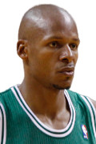
Notes:
Ray Allen
Statline: 18.9 ppg, 4.1 rpg, 3.4 ast
#: 3
Statline: 0
Team: 3

Slide 4
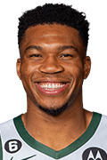
Notes:
Giannis Antetokounmpo
Statline: 21.8 ppg, 9.4 rpg, 4.6 apg
#: 3
Statline: 0
Team: 3

Slide 5
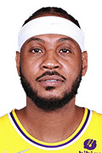
Notes:
Carmelo Anthony
Statline: 22.5 ppg, 6.2 rpg, 2.7 apg
#: 4
Statline: 0
Team: 3

Slide 6
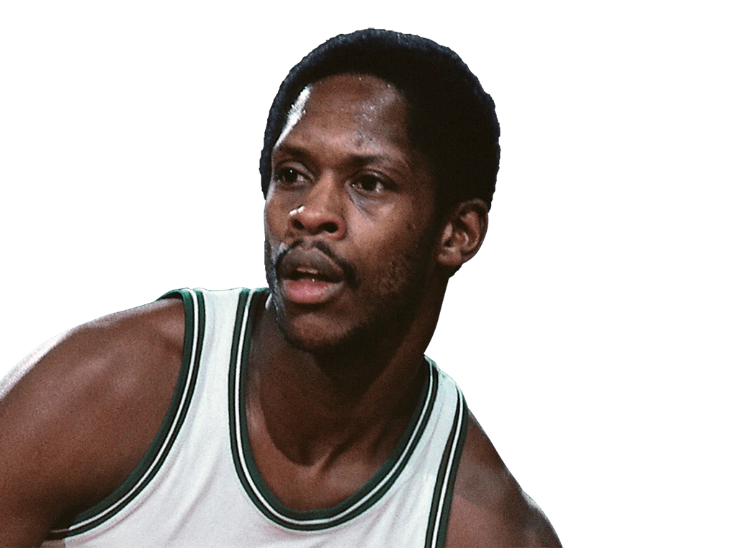
Notes:
Nate (Tiny) Archibald
Statline: 18.8 ppg, 2.3 rpg, 7.4 apg

Slide 7
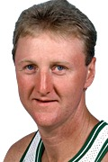
Notes:
Larry Bird
Statline: 24.3 ppg, 10.0 rpg, 6.3 apg
#: 5
Statline: 1
Team: 5

Slide 8
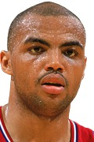
Notes:
Charles Barkley
Statline: 22.1 ppg, 11.7 rpg, 3.9 ast
#: 4
Statline: 0
Team: 2

Slide 9
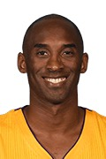
Notes:
Kobe Bryant
Statline: 25.0 ppg, 5.2 rpg, 4.7 apg
#: 6
Statline: 1
Team: 6

Slide 10

Notes:
Dave Cowens
Statline: 17.6 ppg, 13.6 rpg, 3.8 ast

Slide 11
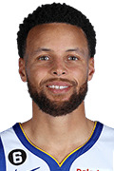
Notes:
Stephen Curry
Statline: 24.3 ppg, 4.6 rpg, 6.5 apg
#: 8
Social: TikTok
Statline: 1
Team: 8

Slide 12
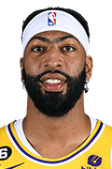
Notes:
Anthony Davis
Statline: 23.8 ppg, 10.2 rpg, 2.3 apg
#: 3
Statline: 1
Team: 3

Slide 13
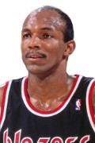
Notes:
Clyde Drexler
Statline: 20.1 ppg, 6.1 rpg, 5.6 apg
#: 3
Statline: 1
Team: 3

Slide 14
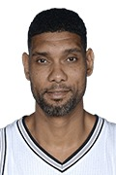
Notes:
Tim Duncan
Statline: 19.0 ppg, 10.8 rpg, 3.0 apg
#: 4
Statline: 1
Team: 3

Slide 15
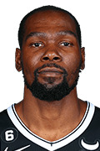
Notes:
Kevin Durant
Statline: 27.2 ppg, 7.1 rpg, 4.3 apg
#: 5
Statline: 2
Team: 5

Slide 16
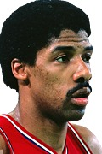
Notes:
Julius Erving
Statline: 24.2 ppg, 8.5 rpg, 4.2 apg
#: 3
Statline: 0
Team: 2

Slide 17
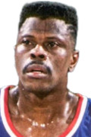
Notes:
Patrick Ewing
Statline: 21.0 ppg, 9.8 rpg, 1.9 apg
#: 3
Statline: 0
Team: 1

Slide 18
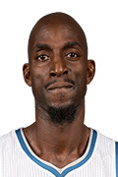
Notes:
Kevin Garnett
Statline: 17.8 ppg, 10.0 rpg, 3.7 apg
#: 4
Statline: 0
Team: 3

Slide 19
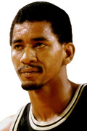
Notes:
George Gervin
Statline: 25.1 ppg, 5.3 rpg, 2.6 apg
#: 2
Statline: 0
Team: 2

Slide 20
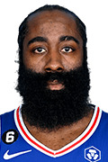
Notes:
James Harden
Statline: 24.9 ppg, 5.6 rpg, 6.8 apg
#: 6
Team: 2
Statline: 3

Slide 21
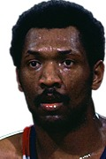
Notes:
Elvin Hayes
Statline: 21.0 ppg, 12.5 rpg, 1.8 apg
#: 1
Statline: 0
Team: 0

Slide 22
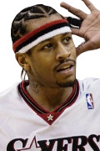
Notes:
Allen Iverson
Statline: 26.7 ppg, 3.7 rpg, 6.2 apg
#: 4
Statline: 1
Team: 4

Slide 23
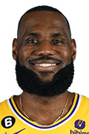
Notes:
Lebron James
Statline: 27.1 ppg, 7.5 rpg, 7.4 apg
#: 7
Socials: Insta
Statline: 1
Team: 6

Slide 24
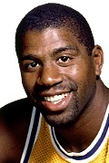
Notes:
Magic Johnson
Statline: 19.5 ppg, 7.5 rpg, 11.2 apg
#: 5
Statline: 1
Team: 5

Slide 25
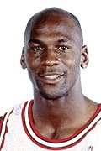
Notes:
Michael Jordan
Statline: 30.1 ppg, 6.2 rpg, 5.3 apg
#: 6
Team: 4
Statline: 1
Socials: TikTok, Last Dance, Twitter

Slide 26
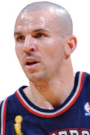
Notes:
Jason Kidd
Statline: 12.6 ppg, 6.3 rpg, 8.7 apg
#: 5
Statline: 1
Team: 2

Slide 27
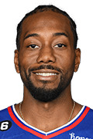
Notes:
Kawhi Leonard
Statline: 19.2 ppg, 6.4 rpg, 2.9 apg
#: 5
Statline: 1
Team: 5

Slide 28
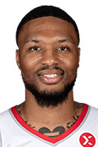
Notes:
Damian Lillard
Statline: 24.6 ppg, 4.2 rpg, 6.6 apg
#: 3
Statline: 1
Team: 3

Slide 29
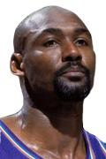
Notes:
Karl Malone
Statline: 25.0 ppg, 10.1 rpg, 3.6 apg
#: 2
Statline: 0
Team: 1

Slide 30
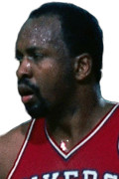
Notes:
Moses Malone
Statline: 20.3 ppg, 12.3 rpg, 1.3 apg
#: 2
Statline: 0
Team: 2

Slide 31

Notes:
Bob McAdoo
Statline: 22.1 ppg, 9.4 rpg, 2.3 apg
Statline:
#: 1
Team: 1

Slide 32

Notes:
Kevin McHale
Statline: 17.9 ppg, 7.3 rpg, 1.7 apg
#: 1
Team: 1
Statline: 0

Slide 33
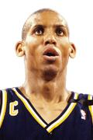
Notes:
Reggie Miller
Statline: 18.2 ppg, 3.0 rpg, 3.0 apg
#: 3
Statline: 1
Team: 3

Slide 34
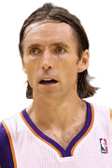
Notes:
Steve Nash
Statline: 14.3 ppg, 3.0 rpg, 8.5 apg
#: 4
Statline: 1
Team: 2

Slide 35
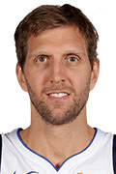
Notes:
Dirk Nowitzki
Statline: 20.7 ppg, 7.5 rpg, 2.4 apg
#: 4
Statline: 1
Team: 4

Slide 36
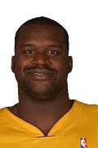
Notes:
Shaquille O’Neal
Statline: 23.7 ppg, 10.9 rpg, 2.5 apg
#: 4
Statline: 1
Team: 3

Slide 37
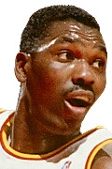
Notes:
Hakeem Olajuwon
Statline: 21.8 ppg, 11.1 rpg, 2.8 apg
#: 3
Statline: 1
Team: 2

Slide 38
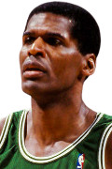
Notes:
Robert Parish
Statline: 14.5 ppg, 9.1 rpg, 1.4 apg
#: 2
Statline: 1
Team: 2

Slide 39
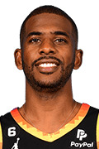
Notes:
Chris Paul
Statline: 18.1 ppg, 4.5 rpg, 9.5 apg
#: 4
Statline: 1
Team: 4

Slide 40
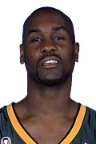
Notes:
Gary Payton
Statline: 16.3 ppg, 3.9 rpg, 6.7 apg
#: 3
Statline: 0
Team:

Slide 41
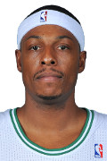
Notes:
Paul Pierce
Statline: 19.7 ppg, 5.6 rpg, 3.5 apg
#: 2
Team: 0
Statline: 0

Slide 42
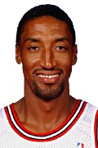
Notes:
Scottie Pippen
Statline: 16.1 ppg, 6.4 rpg, 5.2 apg
#: 4
Statline: 0
Team: 4

Slide 43
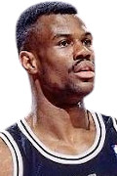
Notes:
David Robinson
Statline: 21.1 ppg, 10.6 rpg, 2.8 apg
#: 3
Statline: 1
Team: 3

Slide 44
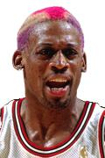
Notes:
Dennis Rodman
Statline: 7.3 ppg, 13.1 rpg, 1.8 apg
#: 3
Statline: 1
Team: 2

Slide 45

Notes:
John Stockton
Statline: 13.7 ppg, 2.5 rpg, 10.5 apg
#: 2
Statline: 0
Team: 2

Slide 46
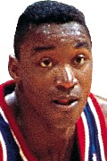
Notes:
Isaiah Thomas
Statline: 19.2 ppg, 3.6 rpg, 9.3 apg
#: 2
Statline: 0
Team: 2

Slide 47
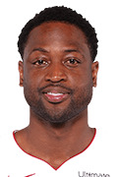
Notes:
Dwyane Wade
Statline: 22.0 ppg, 4.7 rpg, 5.4 apg
#: 3
Statline: 0
Team: 3

Slide 48
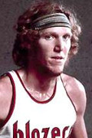
Notes:
Bill Walton
Statline: 13.3 ppg, 10.4 rpg, 3.5 apg
#: 3
Statline: 0
Team: 0

Slide 49
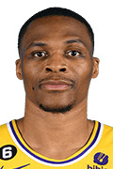
Notes:
Russell Westbrook
Statline: 22.8 ppg, 7.4 rpg, 8.4 apg
#: 4
Statline: 0
Team: 3

Slide 50
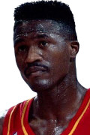
Notes:
Dominique Wilkins
Statline: 24.8 ppg, 6.7 rpg, 2.5 apg
#: 2
Statline: 0
Team: 0

Slide 51
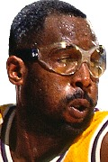
Notes:
James Worthy
Statline: 17.6 ppg, 5.1 rpg, 3.0 apg
#: 3
Statline: 1
Team: 3

